Slide 1
Diffusion Models
Lan Zhang

Slide 2
Overview
Introduction
Mathematical Details
Applications
Conclusion

Slide 3
Overview
Introduction
Mathematical Details
Applications
Conclusion

Slide 4
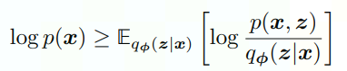
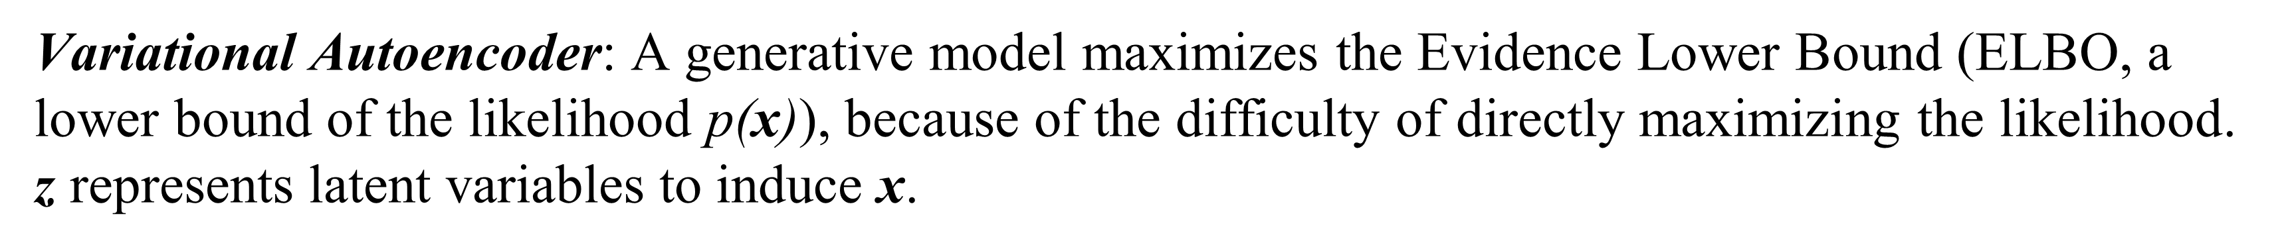
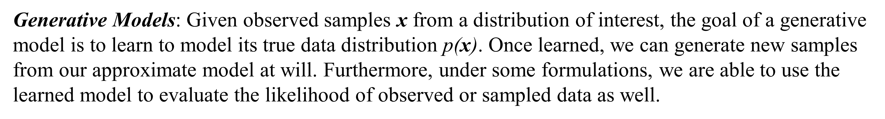
Generative Models
Generative Models: Given observed samples x from a distribution of interest, the goal of a generative model is to learn to model its true data distribution $\text{p}\text{(}\text{x}\text{)}$. Once learned, we can generate new samples from our approximate model at will. Furthermore, under some formulations, we are able to use the learned model to evaluate the likelihood of observed or sampled data as well.
Variational Autoencoder: A generative model maximizes the Evidence Lower Bound (ELBO, a lower bound of the likelihood $\text{p}\text{(}\text{x}\text{)}$), because of the difficulty of directly maximizing the likelihood. $\text{z}$ represents latent variables to induce x.
Understanding Diffusion Models: A Unified Perspective
Calvin Luo
Google Research, Brain Team
2022, arxiv: 2208.11970

Slide 5
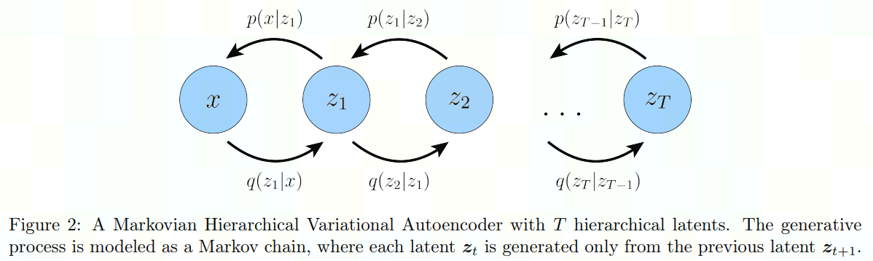
Hierarchical VAE
A Hierarchical Variational Autoencoder (HVAE) is a generalization of a VAE that extends to multiple hierarchies over latent variables. Under this formulation, latent variables themselves are interpreted as generated from other higher-level, more abstract latents.
Understanding Diffusion Models: A Unified Perspective
Calvin Luo
Google Research, Brain Team
2022, arxiv: 2208.11970

Slide 6
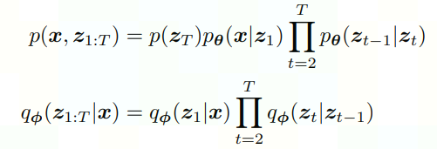
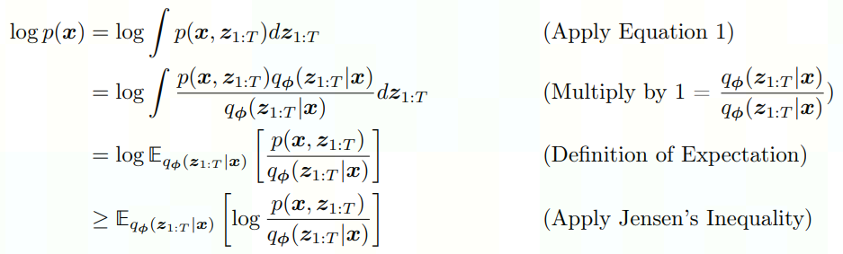
Hierarchical VAE
Understanding Diffusion Models: A Unified Perspective
Calvin Luo
Google Research, Brain Team
2022, arxiv: 2208.11970

Slide 7
Variational Diffusion Models
Variational Diffusion Model is simply as a Markovian Hierarchical VAE with three key restrictions:
The latent dimension is exactly equal to the data dimension.
The structure of the latent encoder at each timestep is not learned; it is pre-defined as a linear Gaussian model.
The Gaussian parameters of the latent encoders vary over time in such a way that the distribution of the latent at final timestep T is a standard Gaussian.
Understanding Diffusion Models: A Unified Perspective
Calvin Luo
Google Research, Brain Team
2022, arxiv: 2208.11970

Slide 8
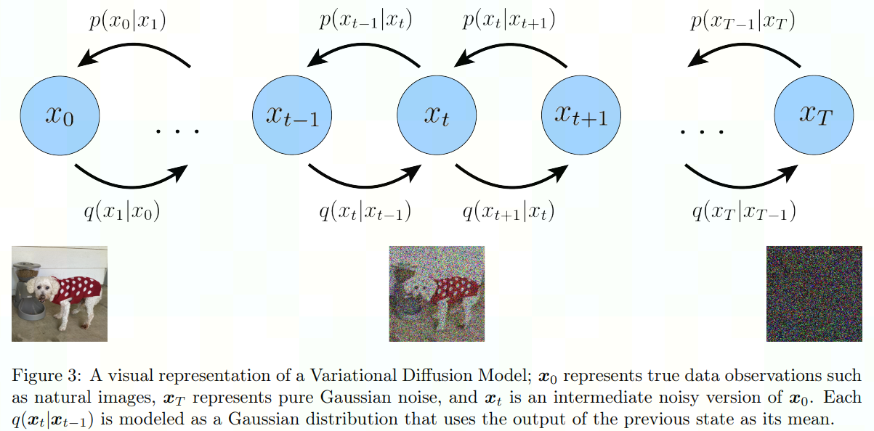
Variational Diffusion Models
Understanding Diffusion Models: A Unified Perspective
Calvin Luo
Google Research, Brain Team
2022, arxiv: 2208.11970

Slide 9
Overview
Introduction
Mathematical Details
Applications
Conclusion

Slide 10
Variational Diffusion Models
Diffusion Model was first proposed in the paper below. The essential idea is inspired by non-equilibrium statistical physics, to systematically and slowly destroy structure in a data distribution through an iterative forward diffusion process. We then learn a reverse diffusion process that restores
structure in data, yielding a highly flexible and tractable generative model of the data.
The goal is to define a forward (or inference) diffusion process which converts any complex data distribution into a simple, tractable, distribution, and then learn a finite-time reversal of this diffusion process which defines the generative model distribution.
Deep Unsupervised Learning using Nonequilibrium Thermodynamics
Jascha Sohl-Dickstein, Eric A. Weiss, Niru Maheswaranathan, Surya Ganguli
ICML, 2015, arxiv: 1503.03585

Slide 11
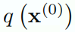
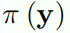
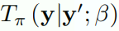
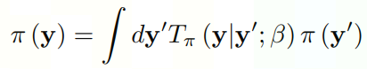
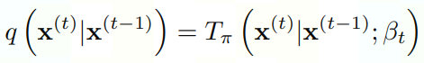
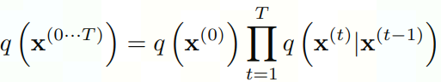
Forward (Inference Diffusion Process)
We label the data distribution . The data distribution is gradually converted into a well behaved (analytically tractable) distribution by repeated application of a Markov diffusion kernel for , where is the diffusion rate.
Deep Unsupervised Learning using Nonequilibrium Thermodynamics
Jascha Sohl-Dickstein, Eric A. Weiss, Niru Maheswaranathan, Surya Ganguli
ICML, 2015, arxiv: 1503.03585

Slide 12
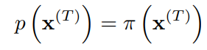
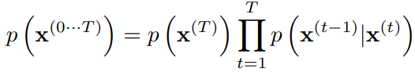
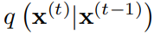
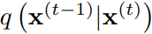
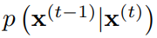
Reverse (Generative Diffusion Process)
For both Gaussian and binomial diffusion, for continuous diffusion (limit of small step size ) the reversal of the diffusion process has the identical functional form as the forward process (On the theory of stochastic processes, with particular reference to applications, W. Feller, 1949). Since is a Gaussian (binomial) distribution, and if is small, then will also be a Gaussian (binomial) distribution. The longer the trajectory the smaller the diffusion rate can be made. Hence, we can modelling with learnable distribution parameters, e.g., the mean and covariance of the reverse Markov transitions for a Gaussian.
Deep Unsupervised Learning using Nonequilibrium Thermodynamics
Jascha Sohl-Dickstein, Eric A. Weiss, Niru Maheswaranathan, Surya Ganguli
ICML, 2015, arxiv: 1503.03585

Slide 13
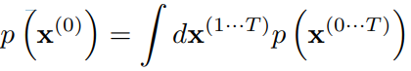
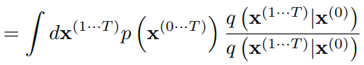
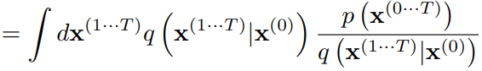
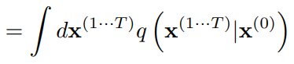
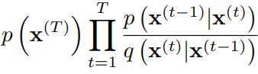
Model Probability
Deep Unsupervised Learning using Nonequilibrium Thermodynamics
Jascha Sohl-Dickstein, Eric A. Weiss, Niru Maheswaranathan, Surya Ganguli
ICML, 2015, arxiv: 1503.03585

Slide 14
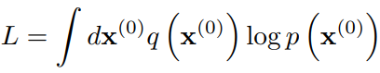
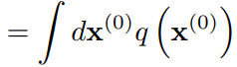
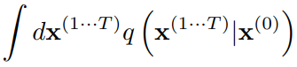
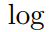
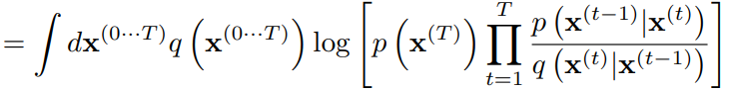
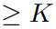
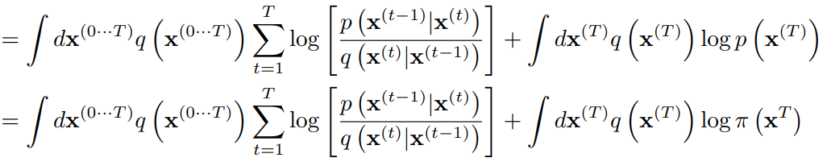
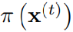
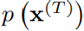
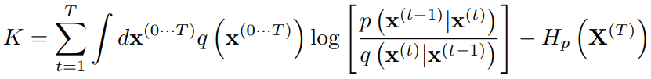
Training
By design, the cross entropy to is constant under diffusion kernels, and equal to the entropy of .
Deep Unsupervised Learning using Nonequilibrium Thermodynamics
Jascha Sohl-Dickstein, Eric A. Weiss, Niru Maheswaranathan, Surya Ganguli
ICML, 2015, arxiv: 1503.03585

Slide 15
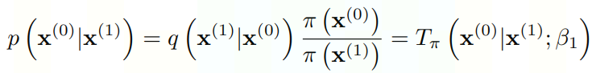
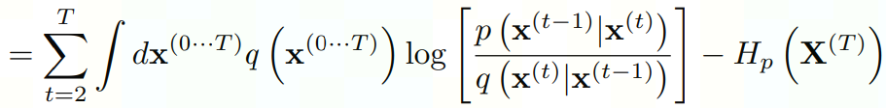
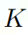
Training
In order to avoid edge effects, we set the final step of the reverse trajectory to be identical to the corresponding forward diffusion step,
We then use this equivalence to remove the contribution of the first time-step in the sum,
Deep Unsupervised Learning using Nonequilibrium Thermodynamics
Jascha Sohl-Dickstein, Eric A. Weiss, Niru Maheswaranathan, Surya Ganguli
ICML, 2015, arxiv: 1503.03585

Slide 16
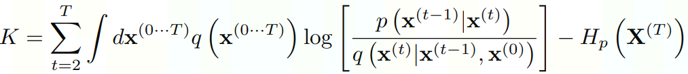
Training
Because the forward trajectory is a Markov process,
Deep Unsupervised Learning using Nonequilibrium Thermodynamics
Jascha Sohl-Dickstein, Eric A. Weiss, Niru Maheswaranathan, Surya Ganguli
ICML, 2015, arxiv: 1503.03585

Slide 17
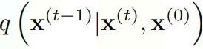
Training
Finally we transform the log ratio of probability distributions into a KL divergence,
Note that the entropies can be analytically computed, and the KL divergence can be analytically computed given and . The key of analytically computing KL divergence is using the reparameterization trick to obtain .
Deep Unsupervised Learning using Nonequilibrium Thermodynamics
Jascha Sohl-Dickstein, Eric A. Weiss, Niru Maheswaranathan, Surya Ganguli
ICML, 2015, arxiv: 1503.03585

Slide 18
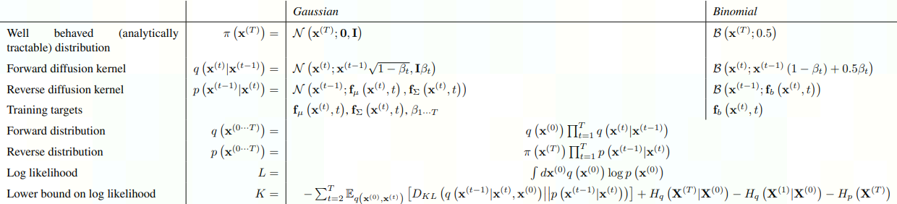
Summary
Deep Unsupervised Learning using Nonequilibrium Thermodynamics
Jascha Sohl-Dickstein, Eric A. Weiss, Niru Maheswaranathan, Surya Ganguli
ICML, 2015, arxiv: 1503.03585

Slide 19
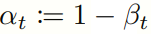
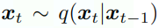
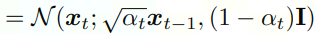
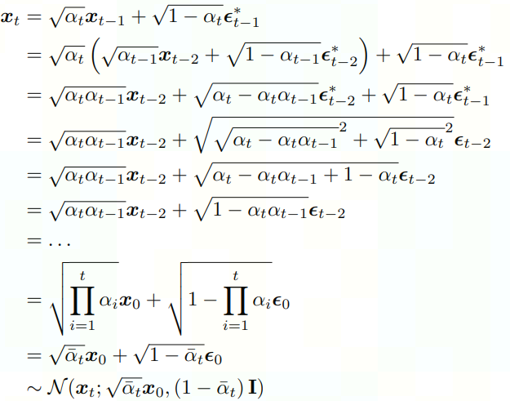
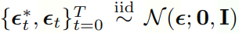
Reparameterization
In the Gaussian case, using the notation , we have .
The sum of two independent Gaussian random variables remains a Gaussian with mean being the sum of the two means, and variance being the sum of the two variances.
Understanding Diffusion Models: A Unified Perspective
Calvin Luo
Google Research, Brain Team
2022, arxiv: 2208.11970

Slide 20
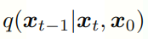
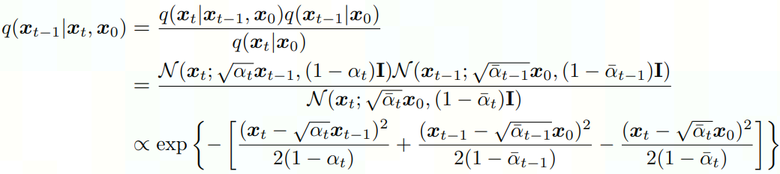
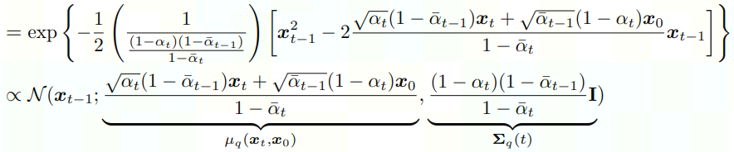
Computing
By Bayes rule, we have:
Understanding Diffusion Models: A Unified Perspective
Calvin Luo
Google Research, Brain Team
2022, arxiv: 2208.11970

Slide 21
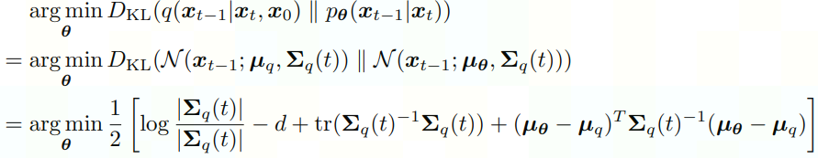
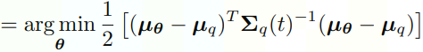
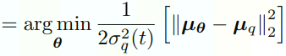

KL Divergence
The KL Divergence between two Gaussian distributions is,
If we set the variances of to match exactly, we have
where
Understanding Diffusion Models: A Unified Perspective
Calvin Luo
Google Research, Brain Team
2022, arxiv: 2208.11970

Slide 22



Further Simplification
is the mean of and conditions on and t only. If we set it to have the similar form with
where is parameterized by a neural network that seeks to predict from and t. The optimization problem simplifies to
Understanding Diffusion Models: A Unified Perspective
Calvin Luo
Google Research, Brain Team
2022, arxiv: 2208.11970

Slide 23




Signal-to-Noise Ratio (SNR) Form
One definition of the signal-to-noise ratio (SNR) is as the mean square divided by variance. In this case, the SNR of each timestep is:
Understanding Diffusion Models: A Unified Perspective
Calvin Luo
Google Research, Brain Team
2022, arxiv: 2208.11970

Slide 24
Overview
Introduction
Mathematical Details
Applications
Conclusion

Slide 25

Image Domain—Diffusion Illustration
Denoising Diffusion Probabilistic Models
Jonathan Ho, Ajay Jain, Pieter Abbeel
NeurIPS, 2020, arxiv: 2006.11239

Slide 26

Image Domain--Interpolation
Denoising Diffusion Probabilistic Models
Jonathan Ho, Ajay Jain, Pieter Abbeel
NeurIPS, 2020, arxiv: 2006.11239

Slide 27

Image Domain—Generation
Variational Diffusion Models
Diederik P. Kingma, Tim Salimans, Ben Poole, Jonathan Ho
NeurIPS, 2021, arxiv: 2107.00630

Slide 28

Text Domain—Language Model
This approach adds a Markov transition from discrete words to a vector in the forward process, parametrized by an isotropic Gaussian distribution centered on the concatenation of word embeddings. In the reverse process, there is a trainable rounding step to recover texts.
Diffusion-LM Improves Controllable Text Generation
Xiang Lisa Li, John Thickstun, Ishaan Gulrajani, Percy Liang, Tatsunori B. Hashimoto
NeurIPS, 2022, arxiv: 2205.14217

Slide 29

Text Domain—Controllable Generation
Diffusion-LM Improves Controllable Text Generation
Xiang Lisa Li, John Thickstun, Ishaan Gulrajani, Percy Liang, Tatsunori B. Hashimoto
NeurIPS, 2022, arxiv: 2205.14217

Slide 30

Text Domain—Controllable Generation
Diffusion-LM Improves Controllable Text Generation
Xiang Lisa Li, John Thickstun, Ishaan Gulrajani, Percy Liang, Tatsunori B. Hashimoto
NeurIPS, 2022, arxiv: 2205.14217

Slide 31


Text Domain—Text Modeling
Latent Diffusion Energy-Based Model for Interpretable Text Modeling
Peiyu Yu, Sirui Xie, Xiaojian Ma, Baoxiong Jia, Bo Pang, Ruiqi Gao, Yixin Zhu, Song-Chun Zhu, Ying Nian Wu
ICML, 2022, arxiv: 2206.05895

Slide 32

Text-to-Image—DALL-E 2
Hierarchical Text-Conditional Image Generation with CLIP Latents
OpenAI
arxiv: 2204.06125

Slide 33

Text-to-Image—DALL-E 2
Hierarchical Text-Conditional Image Generation with CLIP Latents
OpenAI
arxiv: 2204.06125

Slide 34

Text-to-Image—Imagen
Photorealistic Text-to-Image Diffusion Models with Deep Language Understanding
Google Research, Brain Team
arxiv: 2205.11487

Slide 35

Text-to-Image—Imagen
Photorealistic Text-to-Image Diffusion Models with Deep Language Understanding
Google Research, Brain Team
arxiv: 2205.11487

Slide 36
Overview
Introduction
Mathematical Details
Applications
Conclusion

Slide 37
Conclusion
Diffusion models have shown great success in both image generation and text generation.
The basic diffusion model can be coupled with other conditions to have more applications.
Compared to diffusion models in image domain, the intermediate latents in text domain cannot be naturally converted to meaningful texts. This makes it difficult to know what is happening to the original text during the diffusion process.

Slide 38
Thank you for listening!

